Slide 1
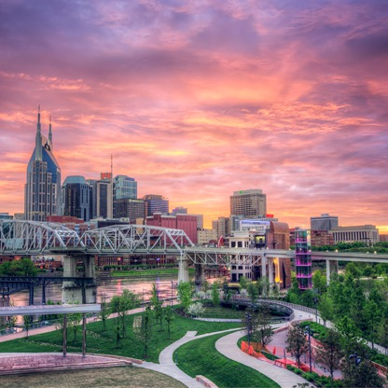
NASHVILLE
OLA HIGH SCHOOL GUITAR, ORCHESTRA, & ART
FEBRUARY 15-17, 2024

Slide 2
BRT: Since 1981
Founded and owned by a band director
Carried over 550,000 travelers in over 6,500 trips
Disney Youth Programs PremEar Travel Planner
The top producer for Disney Performing Arts OnStage programs at the Walt Disney World® Resort
Recipient of Disney’s prestigious Partners Award
Member of the Student & Youth Travel Association and the National Tour Association
Sponsor of the Illinois Music Education Association, the National Band Association, the American Choral Directors Association, among others
Corporate sponsor of the Make-A-Wish Foundation

Slide 3
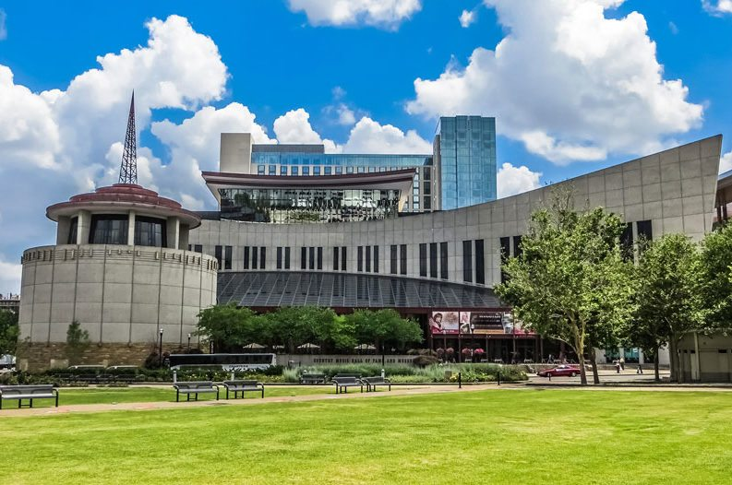
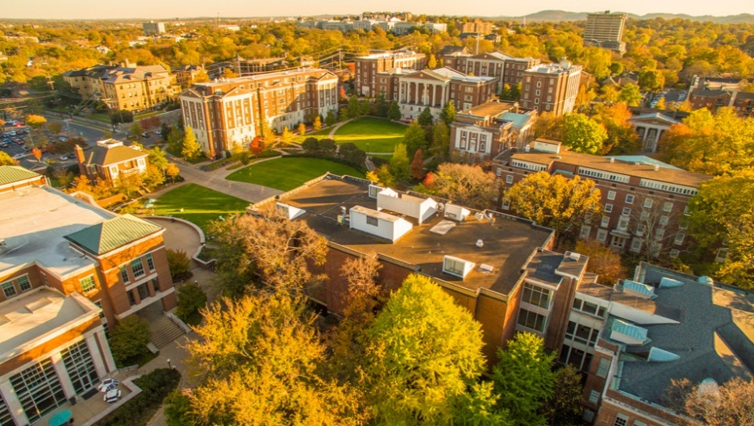
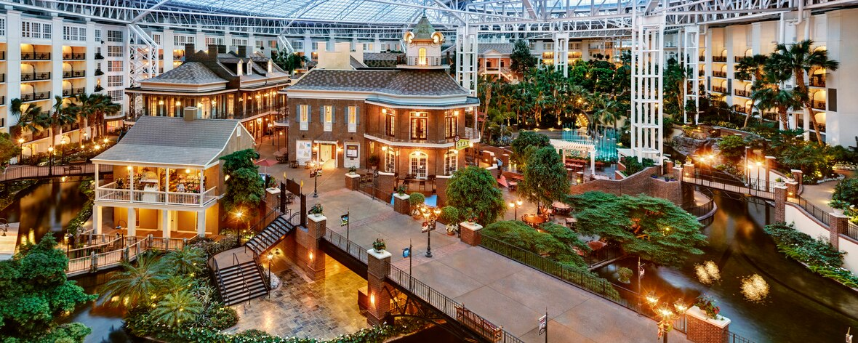
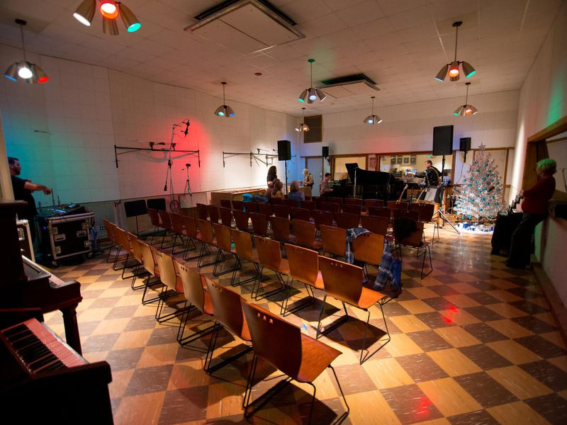
Itinerary Highlights

Slide 4
Trip Inclusions
2 56-passenger motor coaches; gratuities and hotel accommodations for your drivers
2 Nights’ accommodations at Best Western Plus Nashville Airport, Breakfast at hotel
Private nighttime security chaperone at the hotel
Group dinner at Santa Fe Cattle Company
Admission to Frist Art Museum, Ghosts of Nashville Tour, Backstage Tour of the Grand Ole Opry, RCA Studio B, Country Music Hall of Fame, Hatch Show Print
Excursions to Opryland Resort, Nashville Farmers’ Market, Downtown Nashville, Opry Mills Mall, Music Row
Ticket to the Grand Ole Opry
Vanderbilt University Orchestra Clinic, Guitar Clinic, and Art Class (based on availability)
1 Onsite Company Tour Director, all gratuities throughout the tour
Trip T-Shirt
BRT App – Video Souvenir and Tracking/Messaging features
BRT Payments – Individual Payment System

Slide 5
Estimated Trip Cost & Payment Schedule –
**Final Trip Cost depends on number of travelers
Participant Type | Occupancy
Student (80-89 participants) | $699 (all students in quad occupancy)
Chaperone | $779 (double) $935 (single)
Payment Details | Due Date | Amount Due
Trip Registration | May 8 | No money due
Deposit | May 15 | $125 per traveler (+ optional enhanced trip protection)
2nd Payment | July 17 | $150 per traveler
3rd Payment | September 15 | $150 per traveler
4th Payment | November 15 | $150 per traveler
Final Payment | January 2 | Remaining Balance

Slide 6
BRT Payments – How to Register for the Trip
Click on the registration link from the registration form handout:
https://bobrogerstravel.grcoll.co/go/ola9448 **If you went to Orlando, log into your account and enter Trip Code OLA9448
Follow the steps from the registration form to register. Reserve your spot by entering all information requested in RED and enter a payment method. *A parent should register their child. We will email you along the way – messages may go to spam. Please check your spam folder.
**Complete all the steps (personal & billing information) for your spot to be confirmed (Partial registrations will cause your trip to be cancelled)
You can add Enhanced Trip Protection through TripMate when you register – Enhanced Trip Protection is highly recommended
Secure, online payment system
Receive reminder prior to each payment, select auto-pay for ease
Fund-raising amounts can be easily applied to your account until your account is paid in full
Estimated Trip Cost will depend on number of travelers. The more people that go, the lower the cost will be!

Slide 7
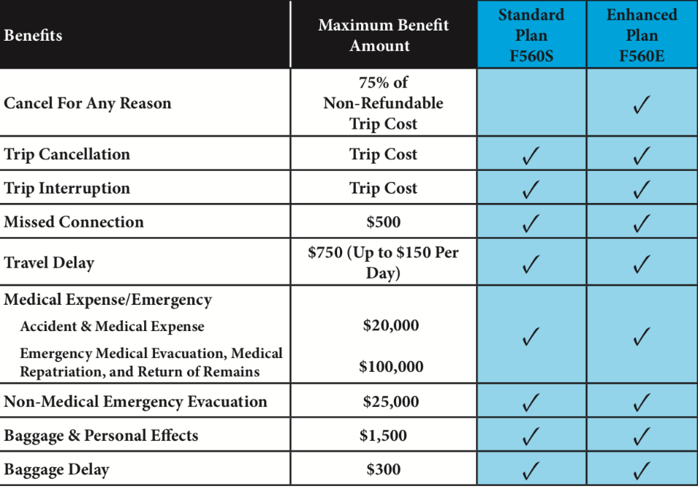
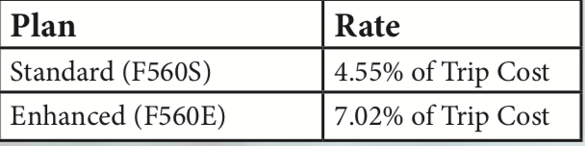
Enhanced (Cancel-For-Any-Reason) Trip Protection
Enhanced Trip Protection is highly recommended and can be added when you register for the trip.
See flyer for coverage details.
As part of your trip registration, you will choose Standard Protection, Enhanced Protection, or decline protection.
Your insurance premium will be charged when you make your trip deposit.
If you want to add Enhanced Trip Protection later, you can log into your account up to 14 days after your deposit to add it.
Questions? A licensed insurance agent can help you when you call the number on the flyer - (844) 777-6856

Slide 8
Scholarships/Fundraising
BRT Moments That Matter Scholarship
  Typically opens in August – Applicants should have a financial need for this scholarship. BRT will consider up to 5 applicants per group, but will only award up to 1 scholarship per group.
  Information will be posted in the fall - https://bobrogerstravel.com/moments-that-matter/
SYTA Youth Foundation Scholarships
  BRT is a member of STYA (Student Youth Travel Association), so students on BRT trips are eligible to apply for SYTA Scholarships
  Details can be found here - https://sytayouthfoundation.org/scholarships
Summer jobs (babysitting, pet-sitting/house-sitting, mowing lawns, asking for trip funds for birthdays and holidays (Trip costs 9 fancy Starbucks drinks per month)

Slide 9
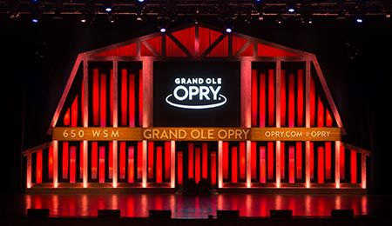
Files You Will Receive
Itinerary
TripMate Insurance Flyer
Registration Form
Go online and reserve your spot tonight!

